Slide 1
Tampines Regional Library
LearnX Community
Pi Python Introductory Course
Course Material
By
Goh Soon Seng
PLEASE DO NOT WRITE ANYTHING ON THE PAGES OF THIS BOOKLET. THANK YOU.

Slide 2
Programme
Python Lesson – Session # 1
LIBRARIES
Machine
picozero
time
tm1637
VARIABLES
LOOPS
while True:
PYTHON RULE
Indentation
Character casing
Python Lesson – Session # 3
TROUBLESHOOTING
MORE PYTHON CODING
PASSWORD
INPUT STATEMENT
Python Lesson – Session # 2
FUNCTIONS
CONDITIONAL STATEMENTS
if else
LOOPS
while True:
for
MESSAGING
how humans and machine communicate with each other
Python Lesson – Session # 4
REVISION & TEST
programming the lights and siren of a patrol car
INTRODUCTION TO CHATGPT
How to login to ChatGPT
Getting ChatGPT to help us code
Learning using ChatGPT

Slide 3
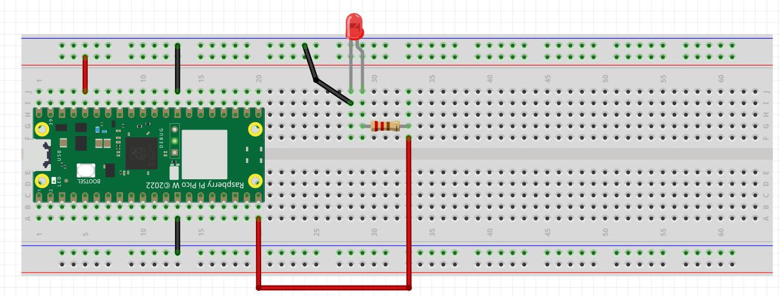
EXERCISE #1
Wiring a Light Emitting Diode (LED)
Please wire up the following circuit
LED
GROUND
_
3.3V
+
GROUND
200 OHM RESISTOR
GROUND
3.3V
PIN 15

Slide 4

TESTING OUR CIRCUIT USING THONNY SHELL
Ex 1a. Turning our Red LED on
>>> from picozero import LED
>>> red_led = LED(15)
>>> red_led.on()
Ex 1b. Turning it off
>>> red_led.off()
Ex 1c. Blinking the red LED
Can you make it Blink too?

Slide 5
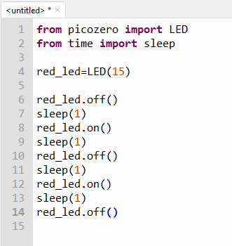
ALGORITHM TO CODE
ALGORITHM
Start with red led off
Wait 1 second
Turn red led on
Wait 1 second
Turn red led off
Wait 1 second
Turn red led on
Wait 1 second
Turn red led off
CODE
RUN and save this as ex1c.py

Slide 6
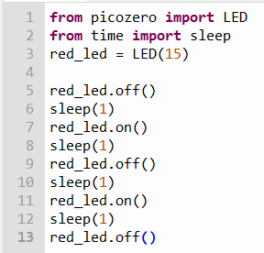
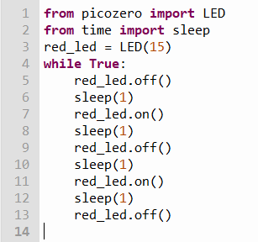
while True:
ex1c.py
Convert
Runs once
Runs forever
Run this new program
Save it as ex1d.py

Slide 7
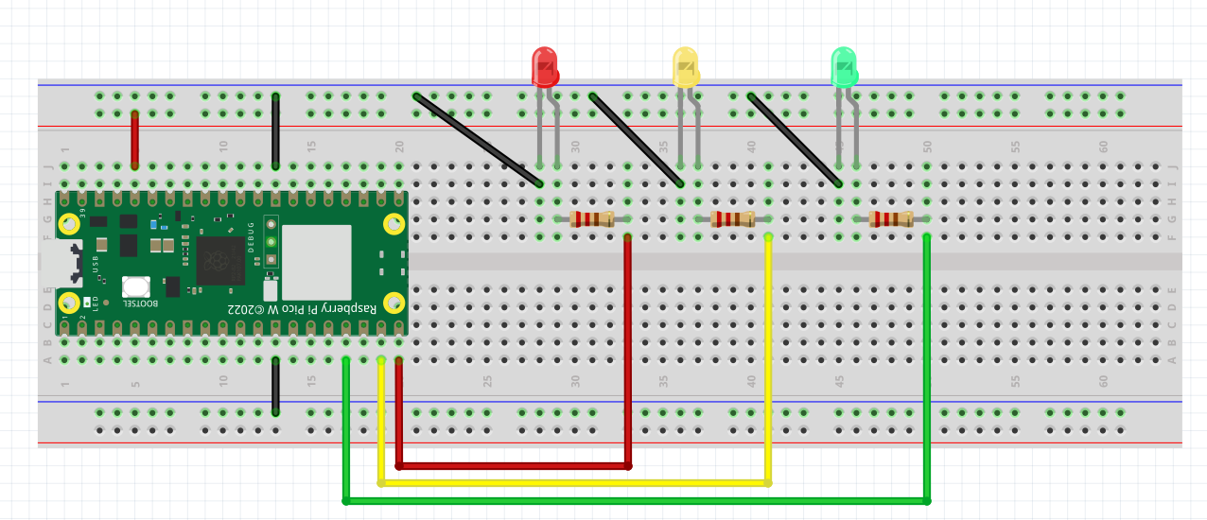
EXERCISE 2 – TRAFFIC LIGHT
Please wire up this new circuit
LED
GROUND
3.3V
GROUND
3.3V
PIN 15
PIN 14
PIN 13

Slide 8
EXERCISE 2 – CONTROLLING MULTIPLE LEDs
Ex 2a. Test the Circuit. Turn each of the LEDs ON and OFF
>>> from picozero import LED
>>> red_led= LED(15)
>>> yellow_led = LED(14)
>>> green_led=LED(13)
Ex 2b. Turning the circuit into a Traffic Light System
Algorithm
Code
How does a traffic light work?
Green Light On
Give cars 10 seconds to cross
Green Light Off
Yellow Light On
Give 5 seconds warning
Yellow Light Off
Red Light On
Wait 10 seconds
Red Light Off
green_led.on()
sleep(10)
green_led.off()
yellow_led.on()
sleep(5)
yellow_led.off()
red_led.on()
sleep(10)
red_led.off()
How?
Code this in the editor
Run and save it as ex2b.py

Slide 9
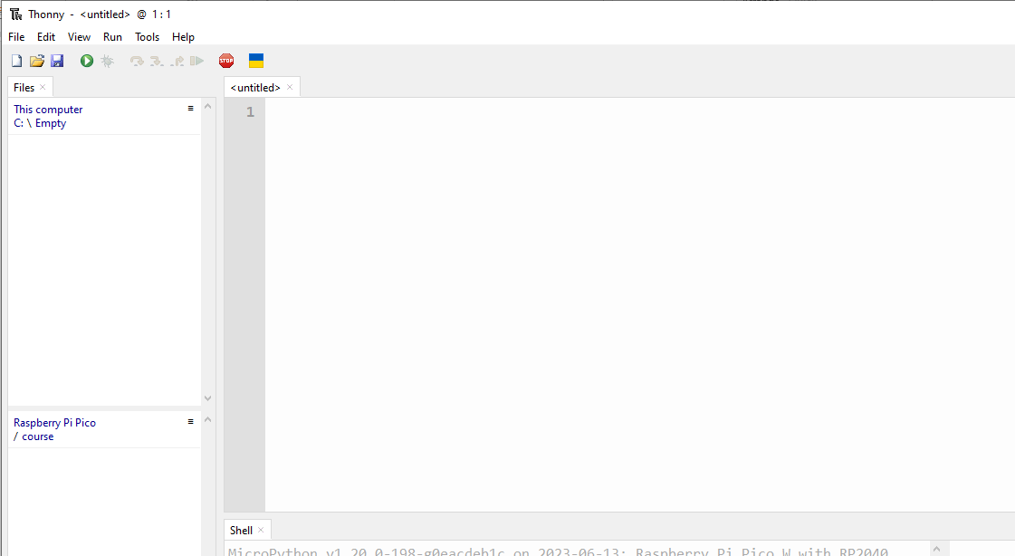
Lets create this program together
from picozero import LED
from time import sleep
red_led = LED(15)
yellow_led=LED( 14 )
green_led=LED( 13 )
Code this in the editor
green_led.on()
Run this program
Green Light On
Give cars 10 seconds to cross
Green Light Off
Yellow Light On
Give 5 seconds warning
Yellow Light Off
Red Light On
Wait 10 seconds
Red Light Off
sleep(10)
Save program as ex2c.py
green_led.off()
yellow_led.on()
sleep(5)
yellow_led.off()
red_led.on()
sleep(10)
red_led.off()

Slide 10
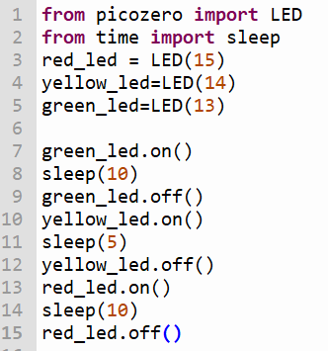
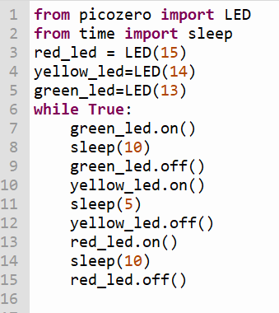
ex2c.py
convert
Runs forever
Runs once
Run the Program
Save it as ex2d.py

Slide 11
Python Lesson – Session # 2
FUNCTIONS
CONDITIONAL STATEMENTS
if else
LOOPS
while True:
for
MESSAGING
how humans and machine communicate with each other

Slide 12
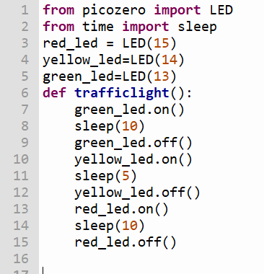

FUNCTION – A SET OF CODES WITH A NAME
ex2d.py
Run the Program
Save it as ex2e.py

Slide 13
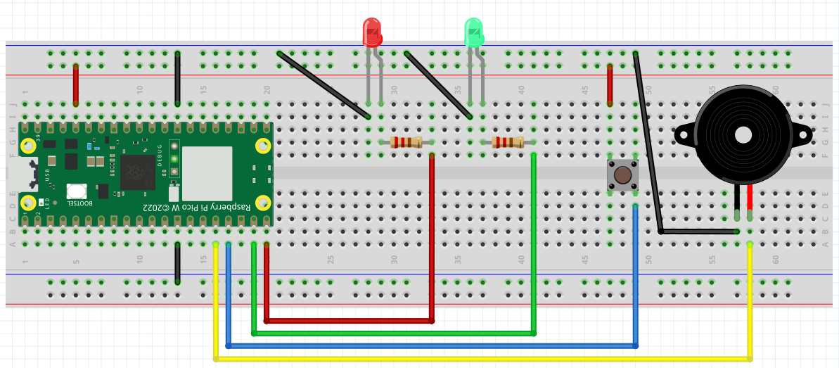
Exercise 3 – Wiring a Pedestrian Crossing
Look for + sign on the Buzzer
BUZZER
_
+
+
PIN 15
PIN 14
PIN 13
PIN 12

Slide 14
TESTING OUR CIRCUIT USING THONNY SHELL
Ex 3a. Turning our Buzzer on
>>> from picozero import Buzzer
>>> buzzer= Buzzer(12)
>>> buzzer.on()
Ex 3b. Turning it off
>>> buzzer.off()
Ex 3c. Setting up multiple sensors : our circuit has Buzzer, Button, LED
>>> from picozero import Buzzer, Button, LED
>>> buzzer= Buzzer(12)
>>> button=Button(13)
>>> red_led=LED(15)
Let’s say we want the LED
To light up when we press the button
And off when we release the button
>>> button.when_pressed = red_led.on
>>> button.when_released = red_led.off
>>> button.when_pressed = buzzer.on
>>> button.when_released = buzzer.off

Slide 15
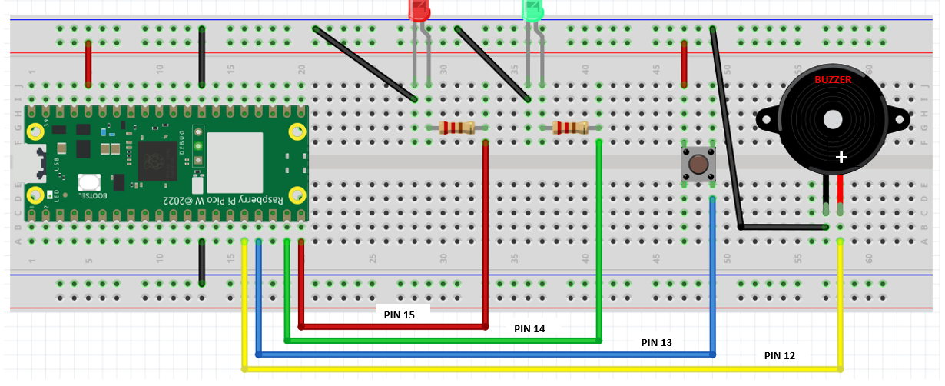
Exercise 3 – Turning the circuit into a pedestrian crossing with code
from picozero import LED, Buzzer, Button
from time import sleep
red_led = LED(15)
green_led=LED(14)
buzzer=Buzzer(12)
button=Button(13)
red_led.on()
green_led.off()
HOW DOES A PEDESTRAIN CROSSING WORK?
sleep(10)
red_led.off()
RED LED IS ON / GREEN LED IS OFF
WAIT FOR 10 SECONDS
RED LED GOES OFF
GREEN LED GOES ON
GIVE 10 SECONDS FOR PEOPLE TO CROSS
GREEN LED GOES OFF
RED LED TURNS ON
green_led.on()
convert
sleep(10)
green_led.off()
RUN and
Save this program as ex3c.py
TO CODE
red_led.on()

Slide 16
Exercise 3 – Turning the circuit into a pedestrian crossing with code
ex3c.py
from picozero import LED, Buzzer, Button
CONVERT THE
RUN ONCE PROGRAM
TO RUN FOREVER
RUN AND SAVE
PROGRAM AS
ex3d.py
from time import sleep
red_led = LED(15)
green_led=LED(14)
buzzer=Buzzer(12)
button=Button(13)
red_led.on()
green_led.off()
sleep(10)
red_led.off()
green_led.on()
sleep(10)
green_led.off()
red_led.on()
RUN ONCE
convert
RUN FOREVER

Slide 17
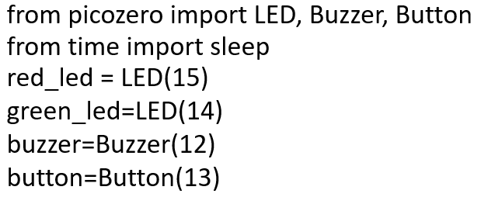

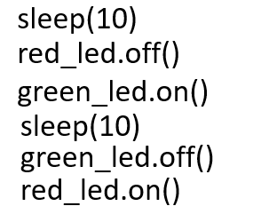
ex3d.py
from picozero import LED, Buzzer, Button
from time import sleep
red_led = LED(15)
green_led=LED(14)
buzzer=Buzzer(12)
button=Button(13)
red_led.on()
green_led.off()
How to convert this into a functon
def greenman():
while True:
sleep(10)
Run program
Save it as ex3e.py
red_led.off()
Give a name for your function. Let’s call it
greenman()
green_led.on()
sleep(10)
green_led.off()
red_led.on()
while True:
greenman()

Slide 18
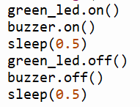
ex3e.py
WAIT FOR 10 SECONDS
RED LED GOES OFF
GREEN LED GOES ON
GIVE 10 SECONDS FOR PEOPLE TO CROSS
GREEN LED STARTS TO BLINK 10 TIMES (10 SECONDS)
BUZZER ALSO BLINKS 10 TIMES (10 SECONDS)
GREEN LED GOES OFF
RED LED TURNS ON
def greenman():
GREEN LED STARTS TO BLINK 10 TIMES (10 SECONDS)
BUZZER ALSO BLINKS 10 TIMES (10 SECONDS)
How?
10 X
while True:
greenman()

Slide 19
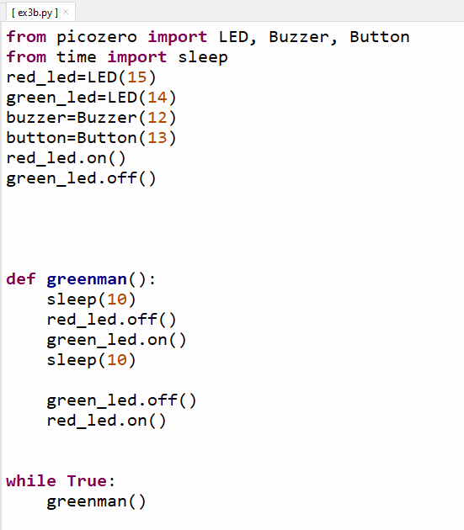
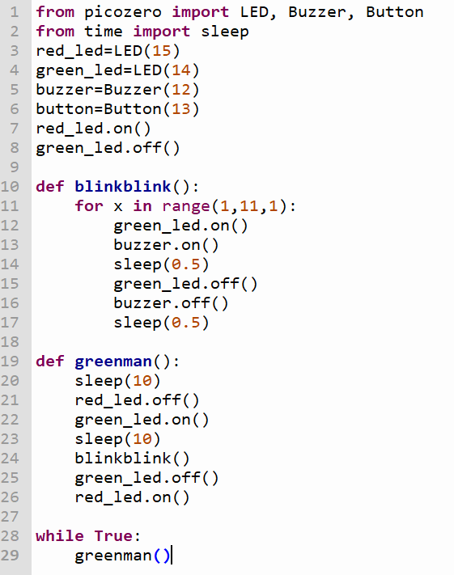
Run program
Save it as ex3f.py

Slide 20
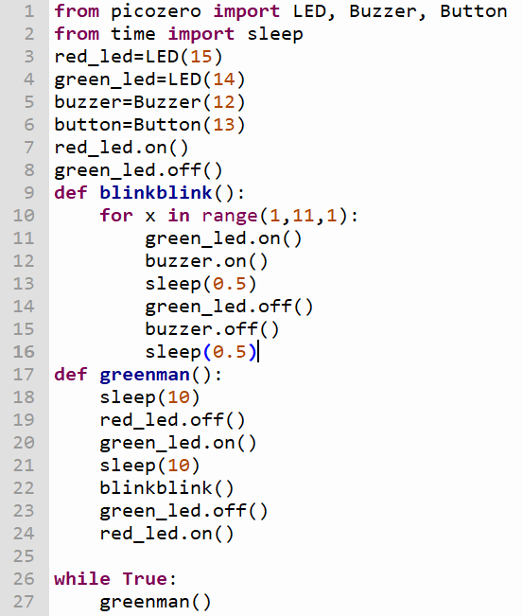


ex3f.py
This program works fine.
But in the real world, it’s not practical.
Why?
If no one wants to cross, the program will still continue to work
We want this program to run only
when someone presses the button. How can we make use of the button
Make this change
Run program
Save it as ex3g.py

Slide 21
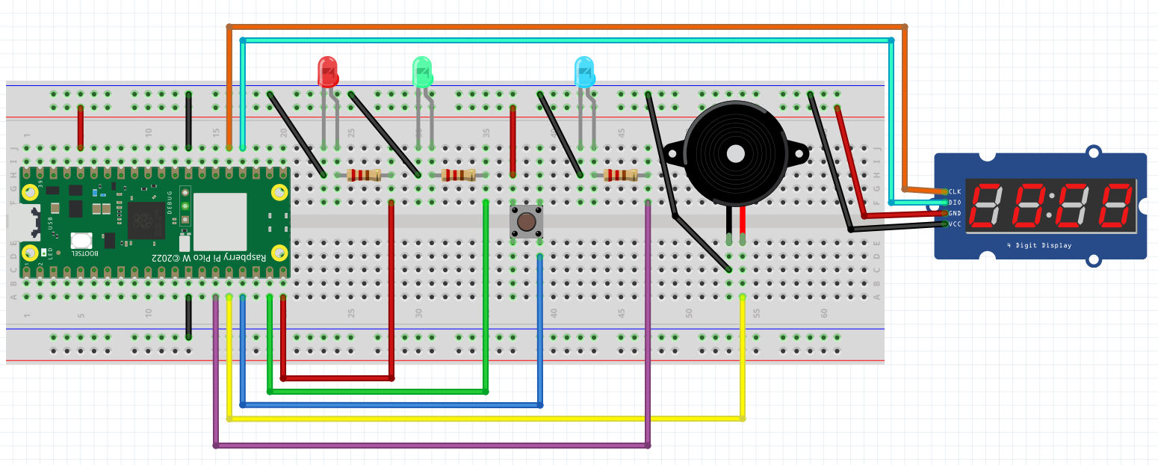

Exercise 4 – Full Fledge Pedestrian Crossing
DIO – Pin 18
CLK – Pin 19
Markings on reverse side
PIN 15
PIN 14
PIN 13
We need another Library
to work with this device,
called a 7 Segment Display
Library: tm1637.py
PIN 12
PIN 11

Slide 22
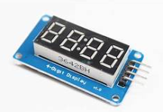
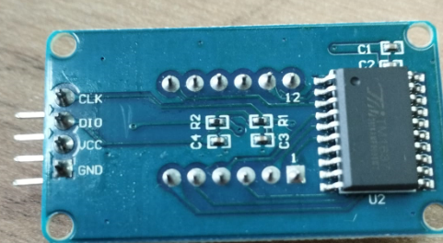
EXERCISE 4a – THE 7 SEGMENT DISPLAY
>>> from machine import Pin
>>> import tm1637
>>> tm = tm1637.TM1637(clk=Pin(19), dio=Pin(18))
>>> tm.show(“help”)
In python " " * 4 means 4 SPACES
This will clear the display.
Make sure there is a SPACE in between the quotation marks
>>> tm.number(1234)
>>> tm.temperature(24)
>>> tm.show(" " * 4)
Exercise 4a. Display the following
PICO
95
70 Degrees Celcius
Clear the display

Slide 23
COUNT DOWN DISPLAY
from machine import Pin
from time import sleep
import tm1637
tm = tm1637.TM1637(clk=Pin(19), dio=Pin(18))
for x in range(10,-1,-1):
tm.number(x)
sleep(1)
Run program
Save as ex4b.py
Try Counting from 0 to 20.
Refer to ex3f.py if you are not sure how to count upwards

Slide 24
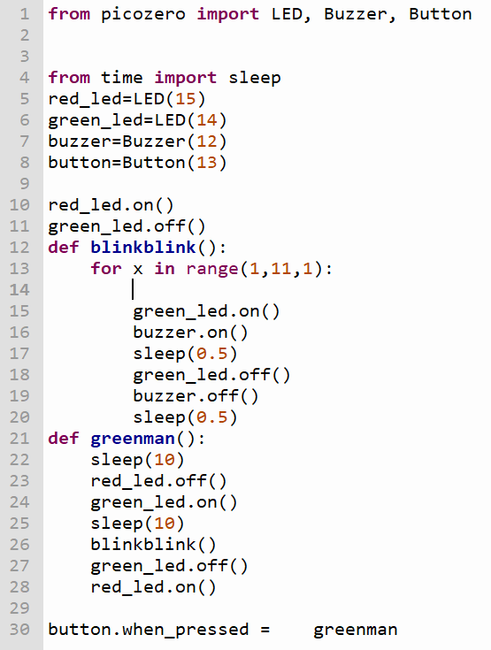
Modify ex3c.py to add
Count down in
blinkblink()
ADDING COUNTER
TO PEDESTRIAN
CROSSING
blinkblink()
Besides the green man
flashing and the buzzer
beeping
the counter will show
how much time left
for crossing
Run this amended program
Save as ex4a.py

Slide 25
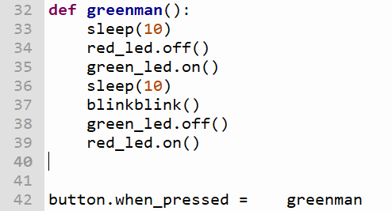
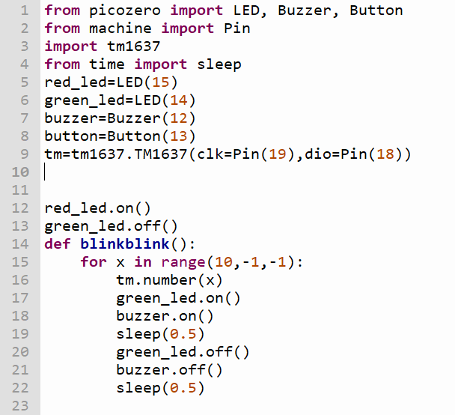

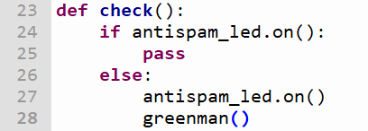
Modify ex4a.py to add antispam control
Run Program
Save as ex4b.py

Slide 26
Python Lesson – Session # 3
TROUBLESHOTTING – 4 BASIC ERRORS
PUTTING PYTHON KNOWLEDGE TO USE
PASSWORD
INPUT STATEMENT

Slide 27
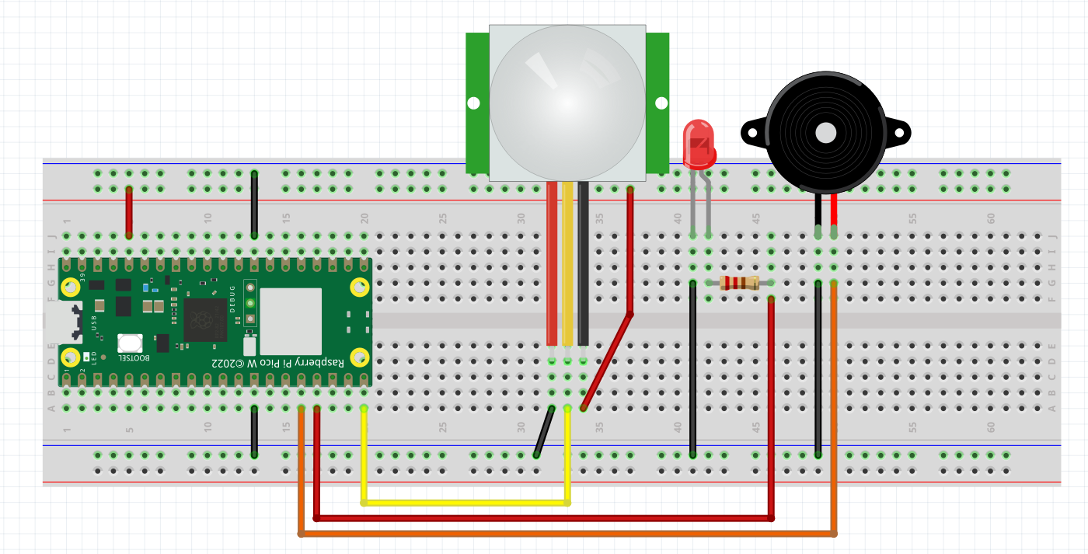
Exercise 5 – Simple Burglar Alarm
PASSIVE INFRA-RED SENSOR - PIR
+
+
PIN 15
PIN 13
PIN 12

Slide 28
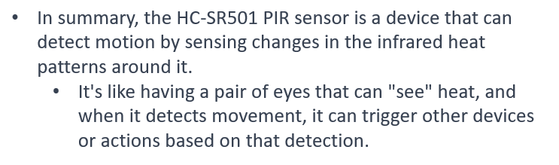
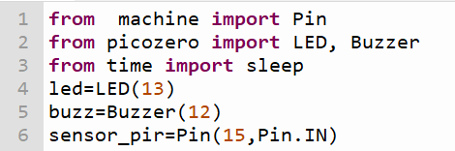
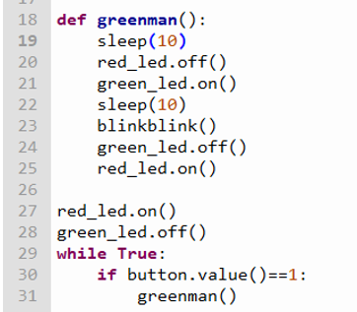
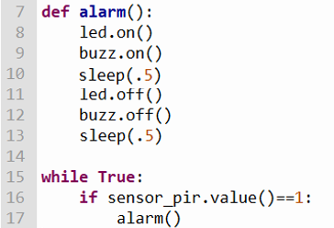
HOW DOES A PIR WORK
Run program
Save as ex5a.py
Actually, it works like a Button
Remember what happens when
A button is pressed in the
Earlier example
We set the Burglar Alarm On
at Night (ARM)
We turn it off in the morning
(DISARM)
To DISARM a password is needed

Slide 29
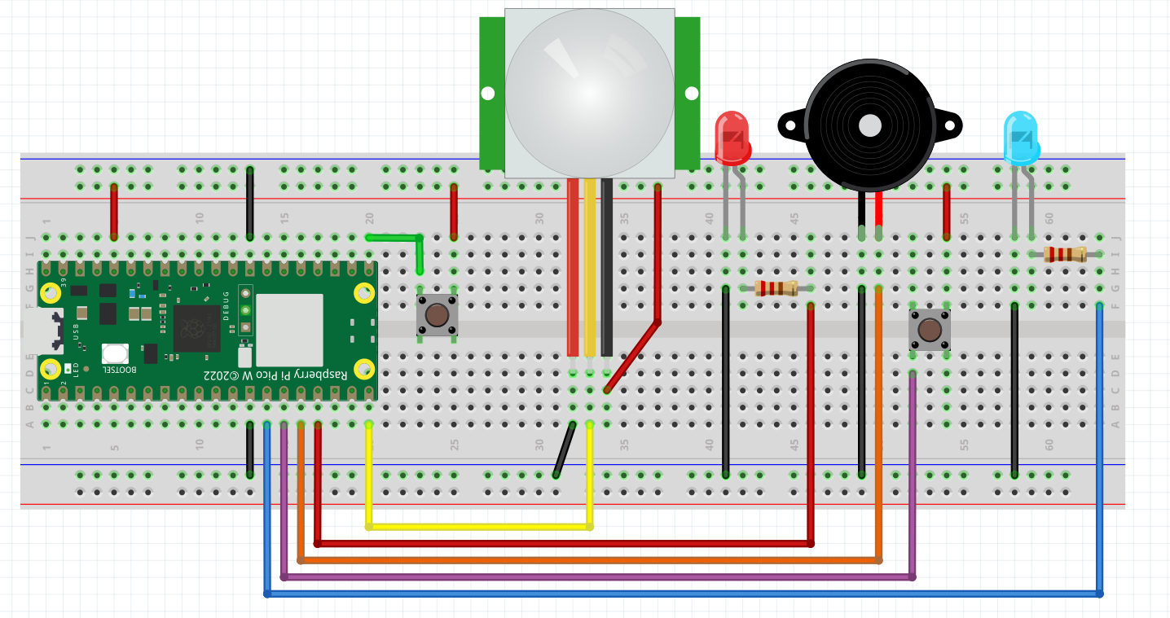
A full fledged Burglar Alarm
PASSIVE INFRA-RED SENSOR - PIR
Exercise 5 – Enhanced Burglar Alarm
_
+
+
+
+
PIN 16
RESET
ARM
PIN 15
PIN 13
PIN 12
PIN 11
PIN 10

Slide 30
Ex 5b. A full fledged Burglar Alarm
A Burglar alarm should work only when it is activated
And should be deactivated when it is not required
RESET BUTTON PRESSED
WHEN MOTION IS DETECTED
ARM BUTTON PRESSED
ARMEDLED ON?
NO
PASS
ARMEDLED ON?
YES
PASS
ARMED LED ON?
NO
PASS
YES
NO
ENTER PASSWORD
YES
TURN ARMED LED ON
RUN ALARM
PASSWORD CORRECT?
NO
TURN ARMED LED OFF

Slide 31
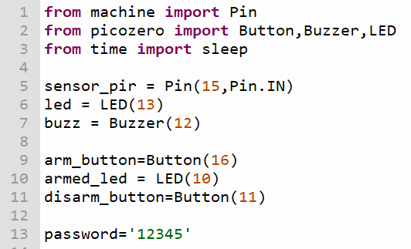
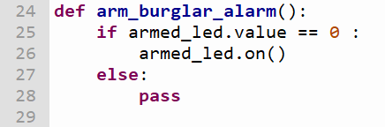
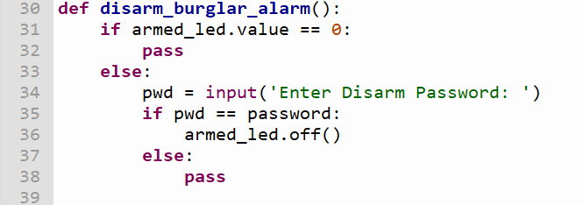
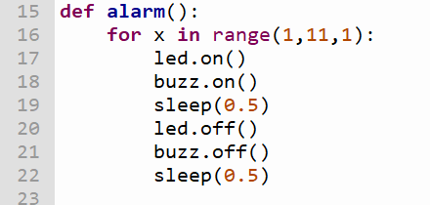
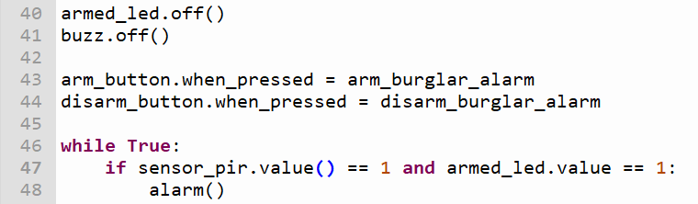
CODE FOR THE FULL FLEDGED BURGLAR ALARM
Run program
Save as ex5b.py
Some perculiarity to take note off

Slide 32
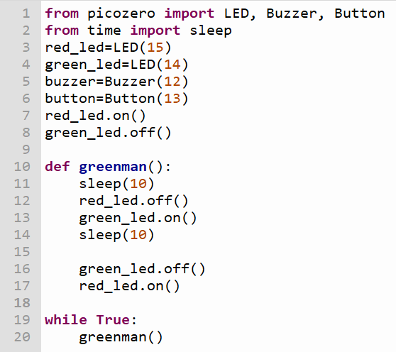
Patrol Car Ex – Putting knowledge gained to use
Use your blue , red LED and a Buzzer to make a noisy flashing lights on a patrol car
Choose any pin you wish
Wire up the circuit and write the python code to make it work
Use this example
HINT
Material
1 x Red LED
1 x Blue LED
1 x Buzzer
Python Code
machine and time library
while True:
Red LED on and off
Blue LED on and off
Sleep in between on and off
Save your program
As patrolcar.py
And RUN

Slide 33
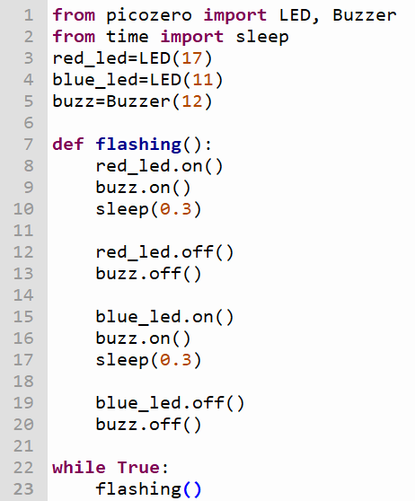
Solution

Slide 34
Python Lesson – Session # 4
REVISION
INTRODUCTION TO CHATGPT
Refer to Traffic Light Wiring Diagram
How to use CHATGPT to write us the program
Keywords in prompt
Micropython
Pico W
Use picozero library
Specify components and pin numbers
Provide the algorithm if available

